Slide 1



DAFNI Executive board – 17/02/2021
Champion update
Juste Raimbault
CASA, UCL
Notes:
1

Slide 2
Since last update:
Improve parameter settings for the MATSim docker (area, seed, iterations, threads, memory)
Sensitivity analysis (stochasticity) of one-mode MATSim; run on a large set of areas
MATSim visualisations and output indicators
Dissemination
Current work:
Four-stage model for travel demand: gravity model for O-D flows
Multimodal data and model
Future work:
Health indicators downstream MATSim
Calibration and validation using OpenMOLE
Current work update
Notes:
2

Slide 3
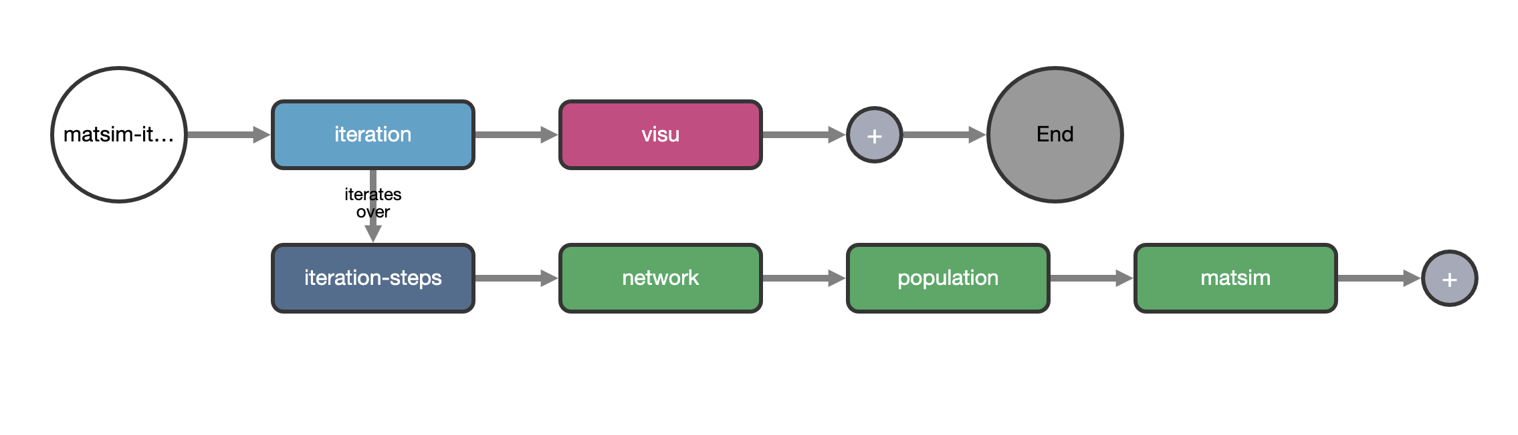
MATSim sensitivity analysis workflow on DAFNI
Issue with iterator on the platform -> run without the workflow system as an ad-hoc shell script
Notes:
3

Slide 4
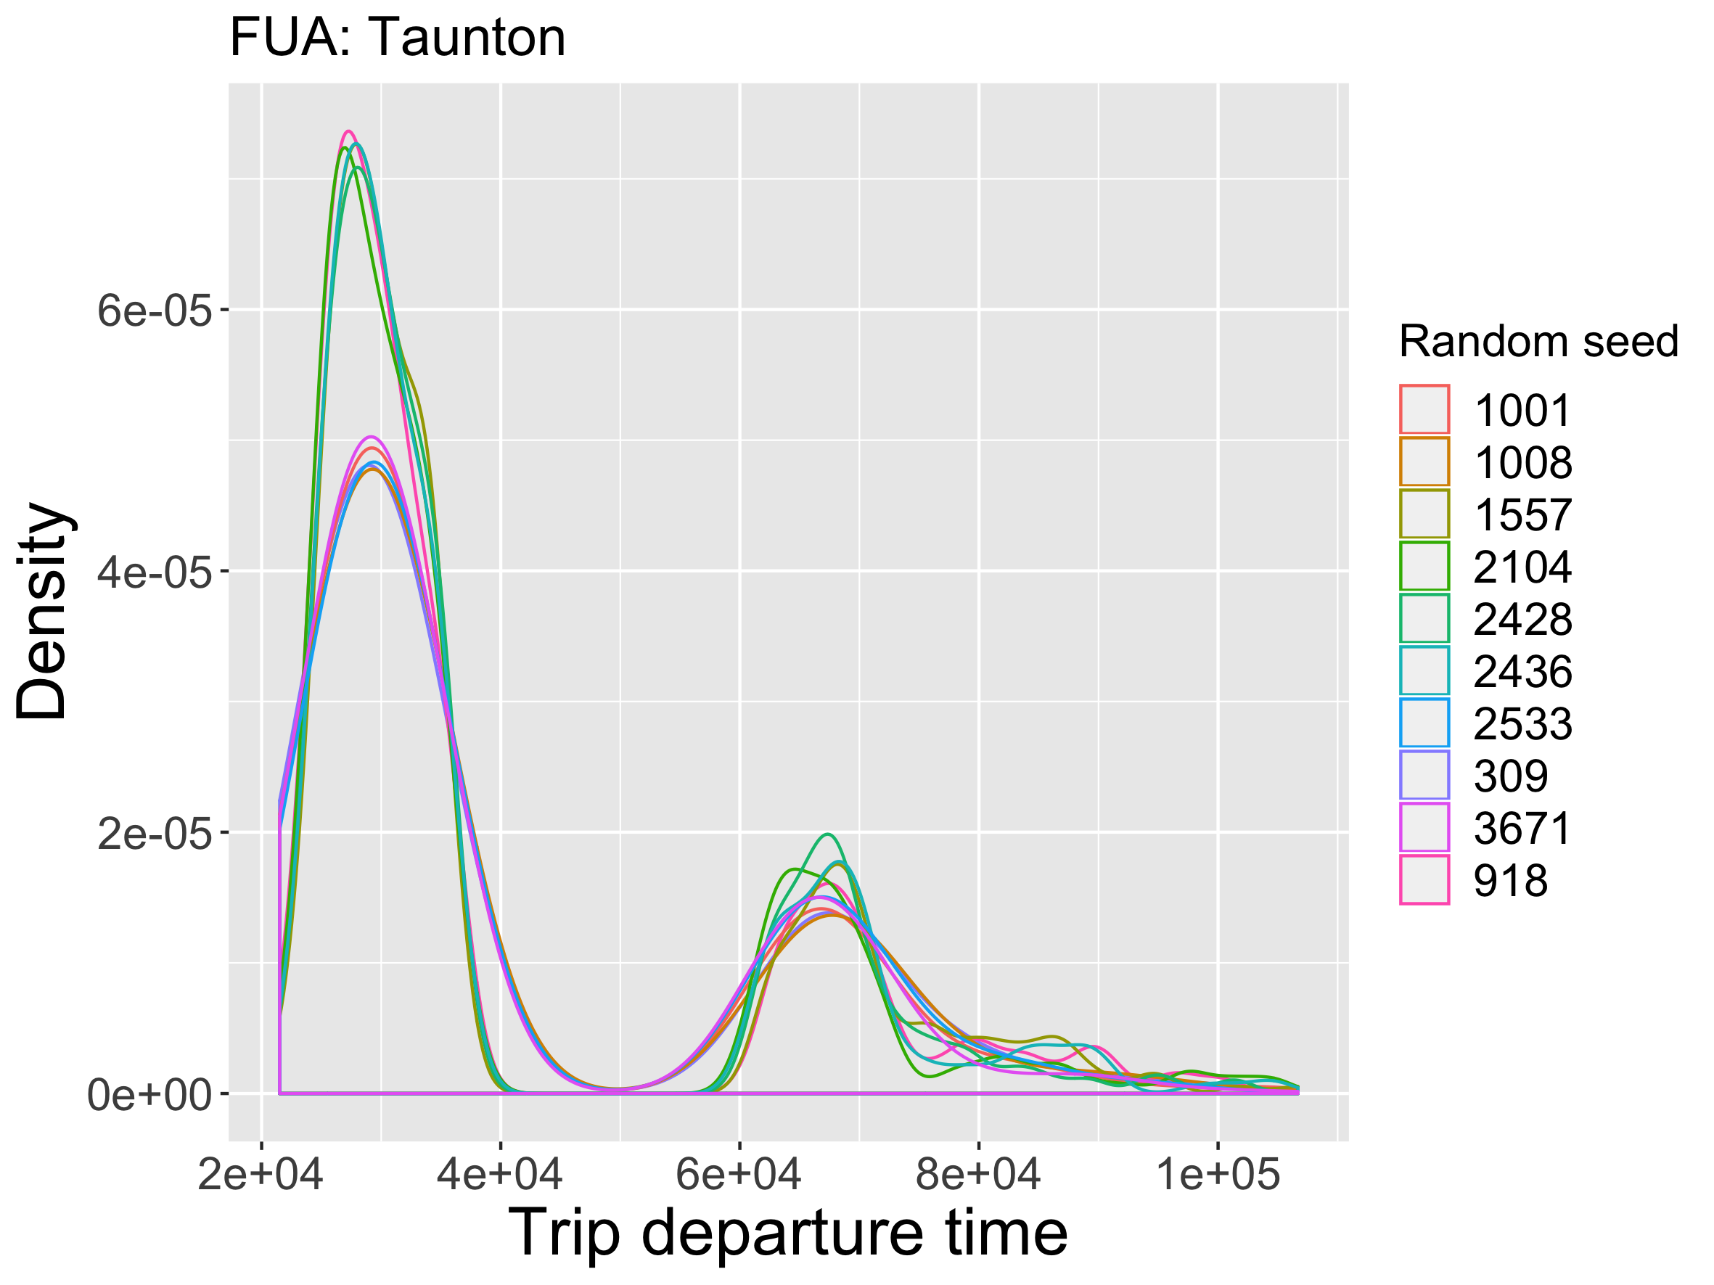
Simulation results: sensitivity analysis
Distribution of trip departure times for different repetitions on the same configuration
Notes:
4

Slide 5
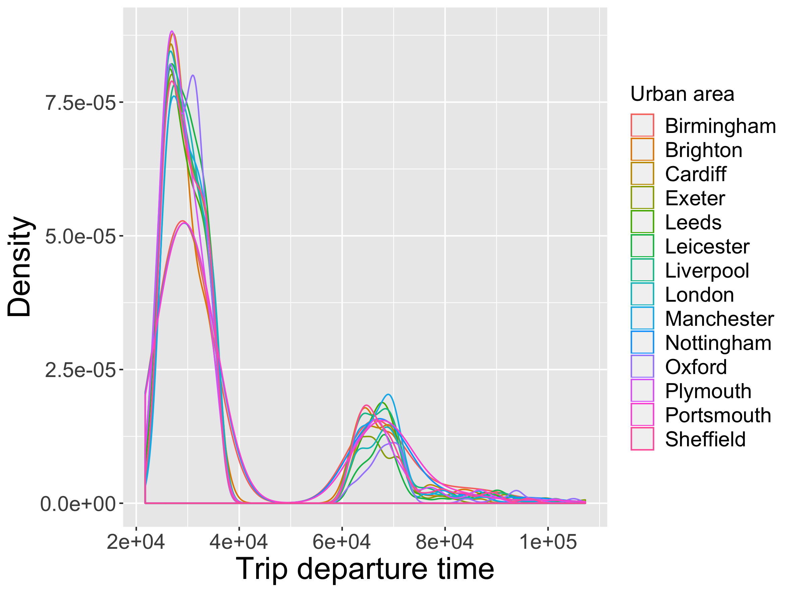
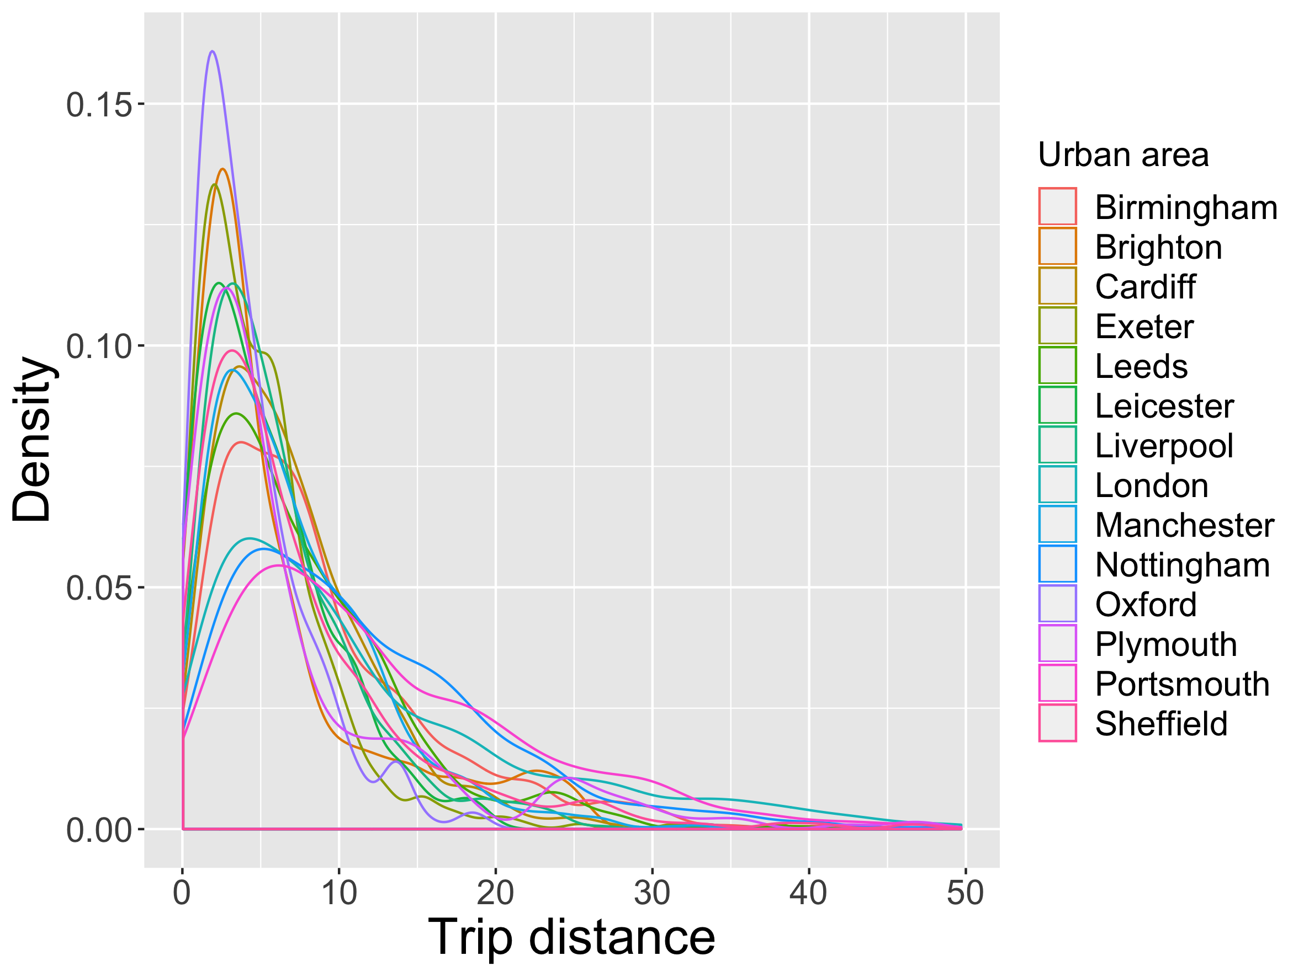
Simulation results: model runs on largest FUAs
Distributions of trip departure times and distances for the largest urban areas
Notes:
5

Slide 6
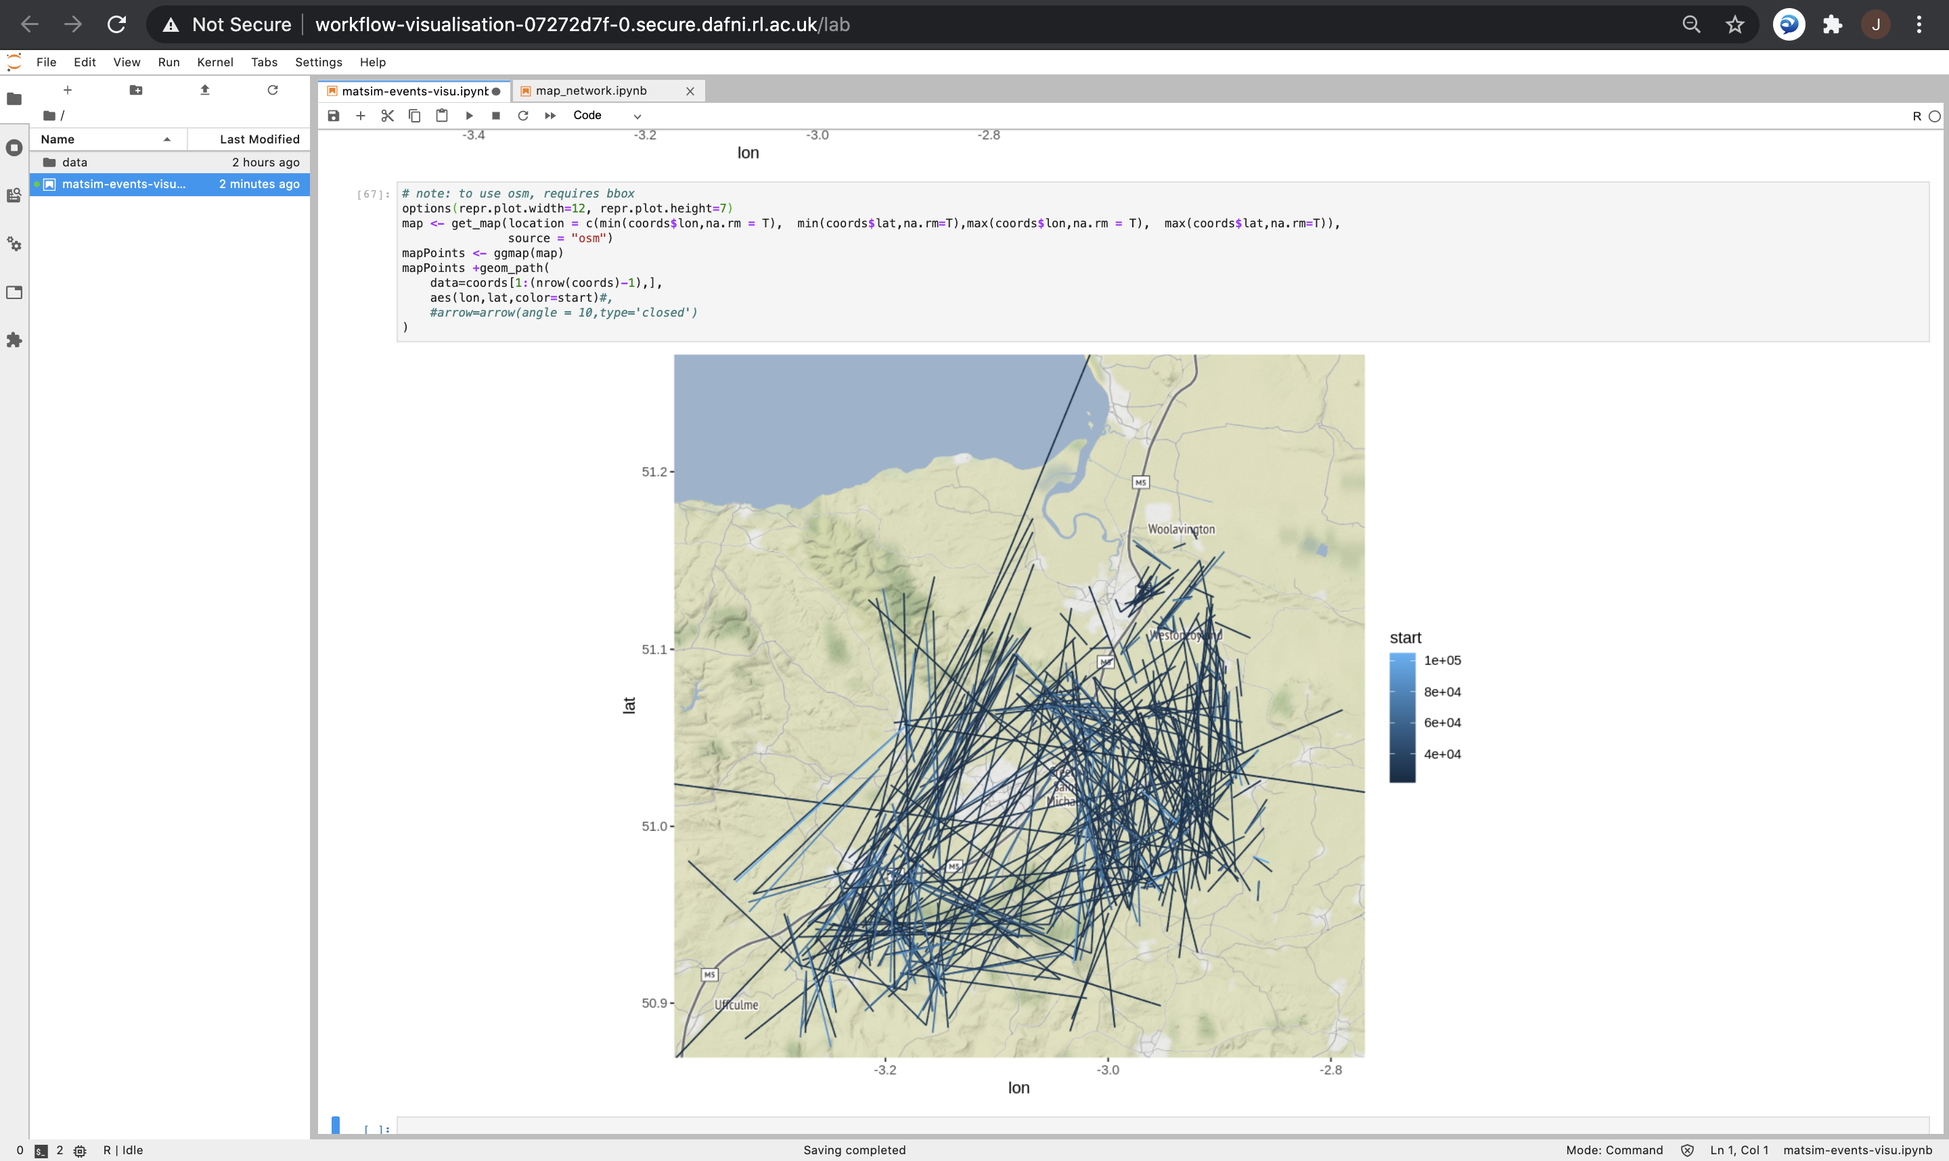
MATSim visualisation and outputs
Test of the OTFVis tool -> open source version only converts to a specific format, conversion into movie files is proprietary; implementation of a similar ad-hoc solution with NetLogo?
Implement output indicators: trip statistics
Ad-hoc visualisation of trips
Notes:
6

Slide 7
Dissemination
Conferences
Presentation at the Applied Urban Modelling conference (28/01/2021): “Building and validating modular urban transportation models using scientific workflow systems” -> Recording at https://youtu.be/jTxsr--scJk?t=4376
Submitted extended abstract to the EWGT2021 conference (full paper due in May): ”Scientific workflow systems as platforms to integrate modular urban transportation models”
Submitted extended abstract to GISRUK 2021 conference: “Estimating public transport congestion in UK urban areas with open transport models”
Roadshow event: wait for results with public transport – aim for April/May
Notes:
7

